Slide 1
Homework 6 – PID Switching
Yi Chen
4/12/2020

Slide 2
Overview
PID switching algorithm
System setup in Simulink
Controller design
System response
System response in comparison to fixed controller
Summary
Reference
Professor’s note: Step responses don't show much in adaptation. It is preferable to use square wave as an input so you can see the adaptation progress. You can open the period enough so that the response reaches a steady state.
→ Works were done after the presentation to redesign the controller set as well as using a pulse train to analyze the system

Slide 3
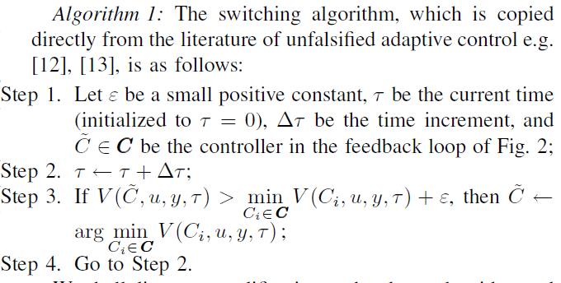
Switching Algorithm
Algorithm proposed from the paper on Unfalsified Adaptive Control:

Slide 4
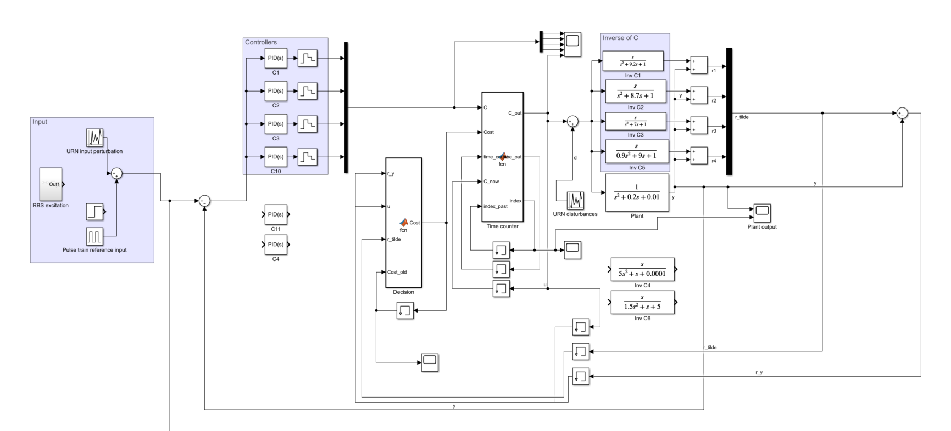
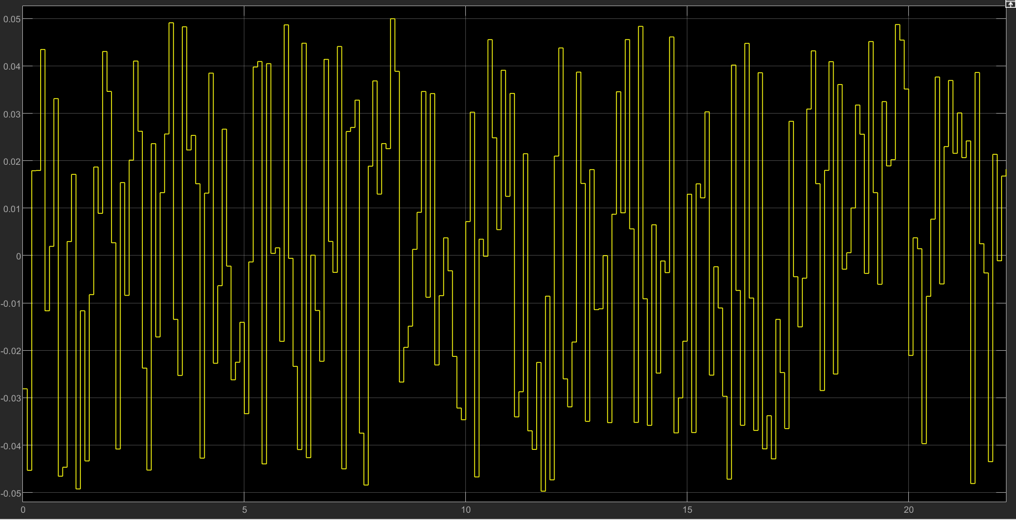
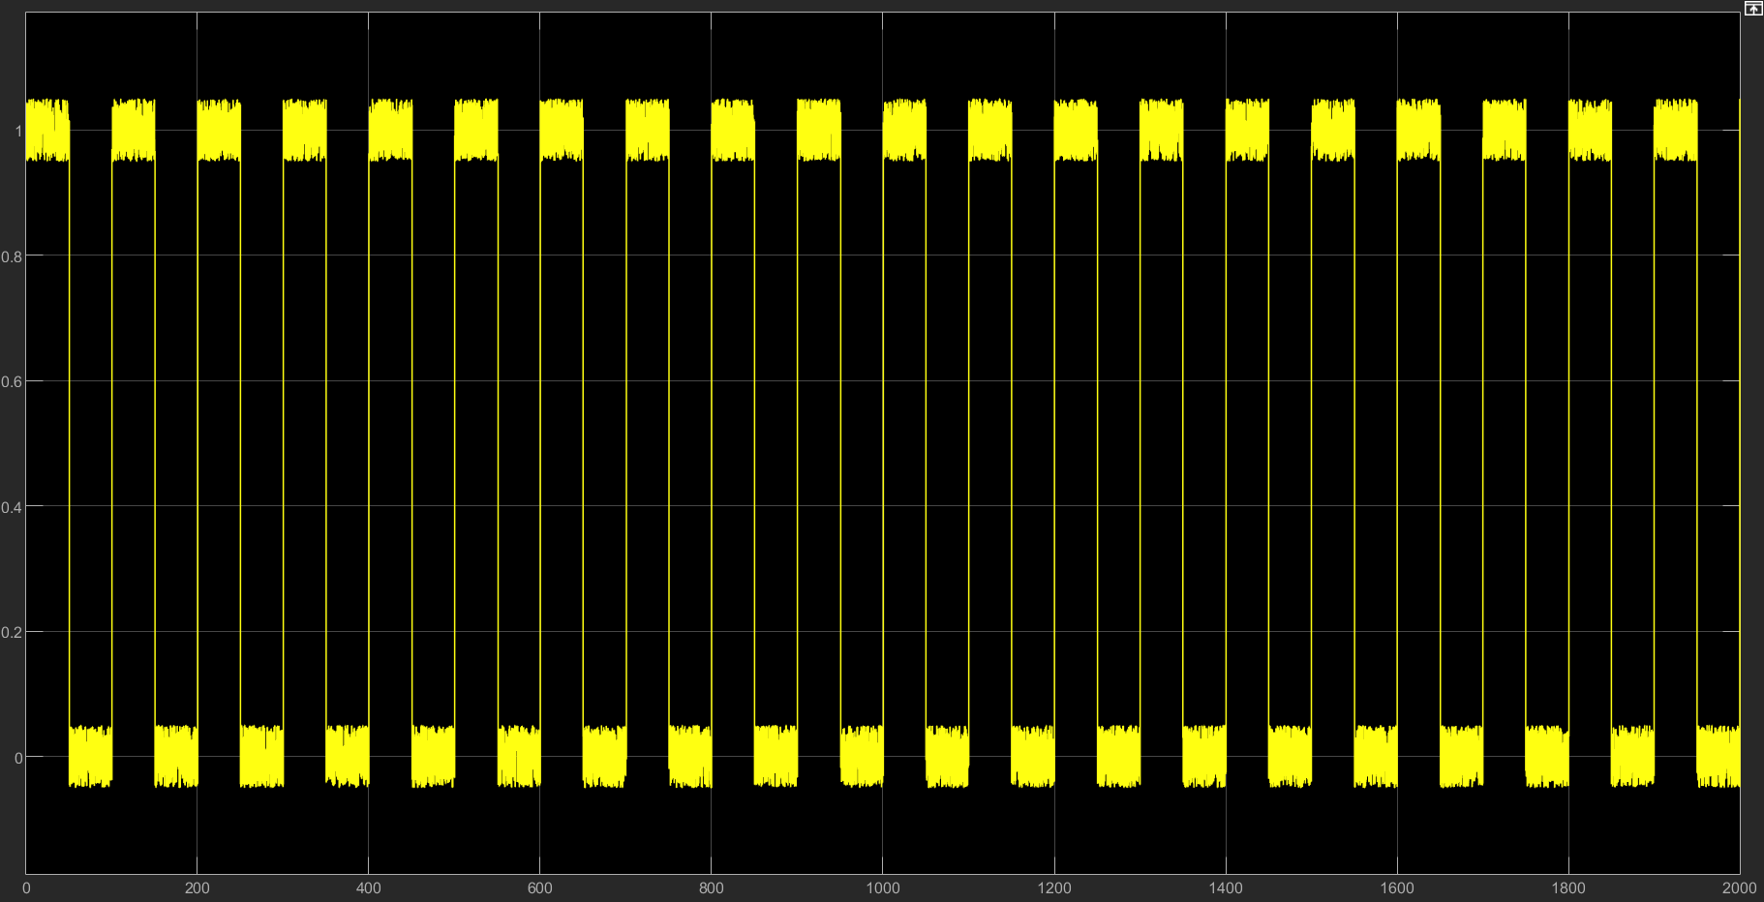
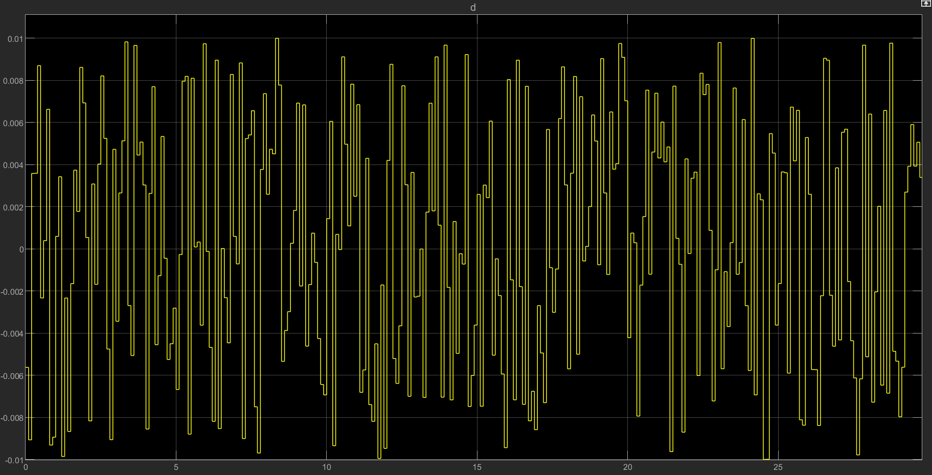


System Setup
Inverse of PID controller
Objective: design a good tracking controller to the reference input for plant 1
Input excitation:
Random Number steps
$\tilde{r}$: fictitious reference signal
$$\tilde{r}=C_{i}^{−1}u+y$$
Time counter and switching
Reference input: period = 100s
Cost function
Disturbance:
Random Number
[-0.1, 0.1]
In this case we are using the proposed forward-path unfalsified adaptive controller setup.

Slide 5
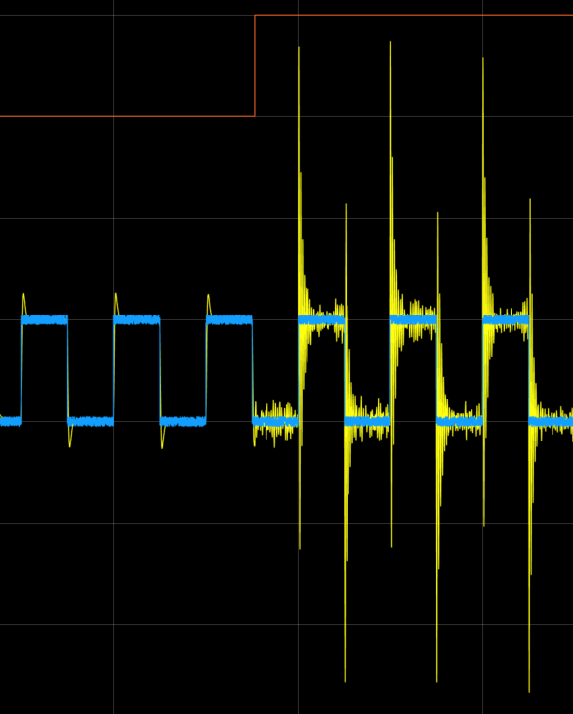
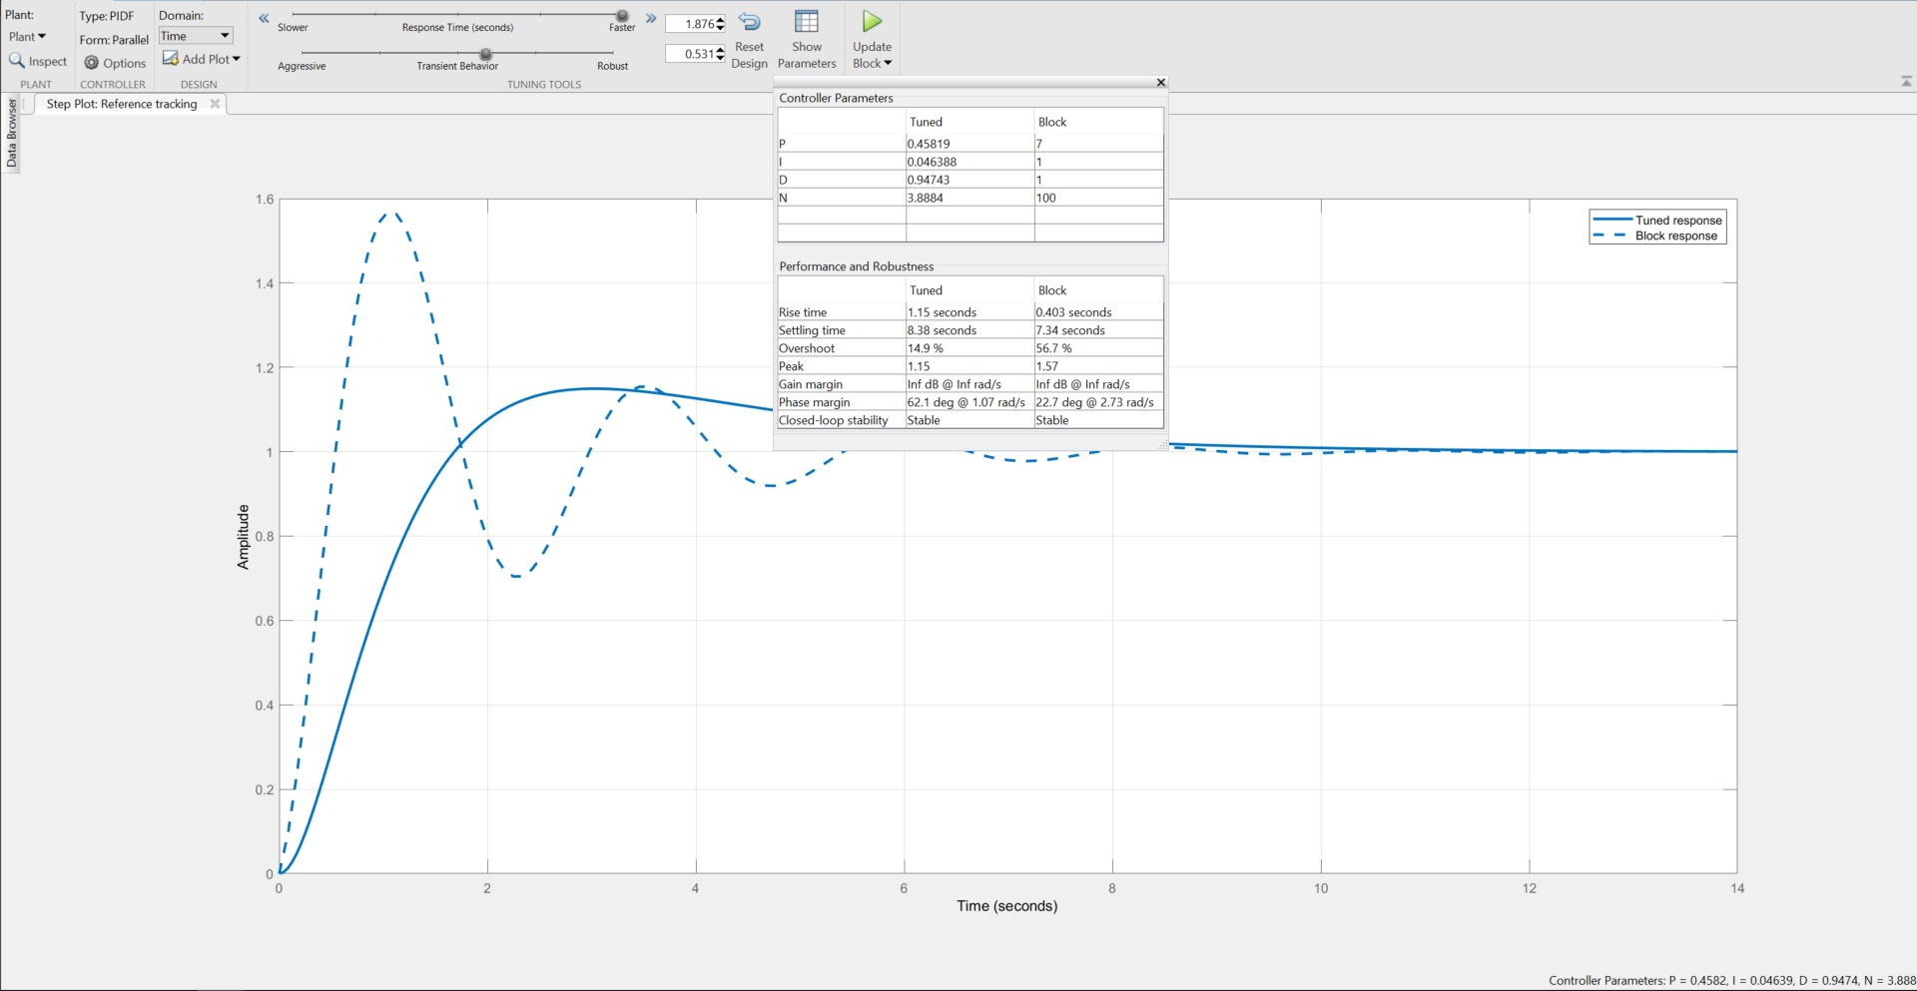
PID controllers
Tuned | Poorly tuned
Numerical design parameters:
% Overshoot: 15%
Rise time: 1.15
Controller 3 and 4 are designed using PID tuner
Controller 1 and 2 are poorly tuned with trial and error
C1: [kp ki kd] = [10 1 1]
C2: [kp ki kd] = [9 1 0.9]
C3: [kp ki kd] = [0.45 0.046 0.947]
C4: [kp ki kd] = [0.5 0.05 0.9]
Before tuning vs after tuning

Slide 6

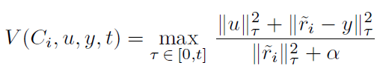
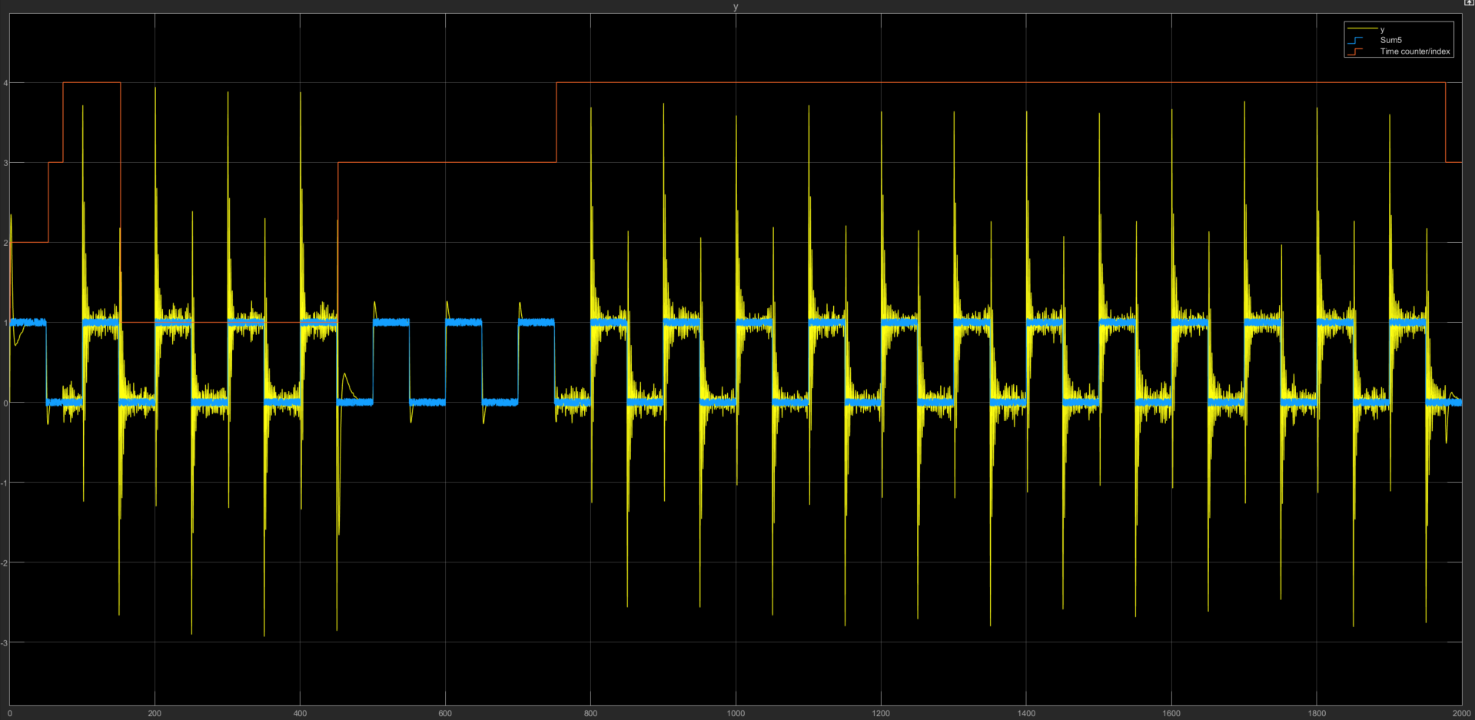
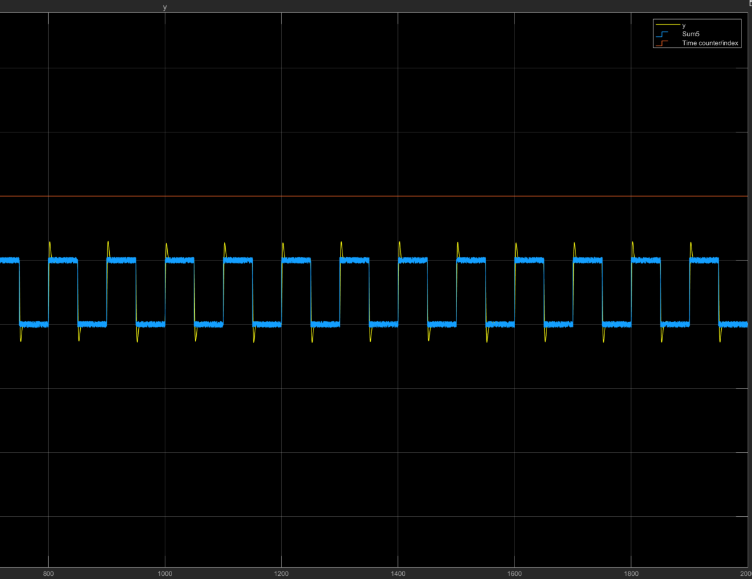

Cost function comparison
Two cost functions proposed in different papers were tested for the use in our plant.
$$V\left(C, u, y, t\right)=max$$
Cost function on the right better reflected our definition desired controller

Slide 7
Effect of Dwell time on system response
Here we investigate the effect of dwell time on the transient response of the system, as discussed in the paper.
Higher disturbance ([-0.1, 0.1]) were introduced to encourage switching.
Similar number of switches trend to the one proposed in the paper.
Dwell-Time | 0.1 | 1 | 3 | 6 | 10
Number of switches | 2 | 1 | 1 | 1 | 1

Slide 8
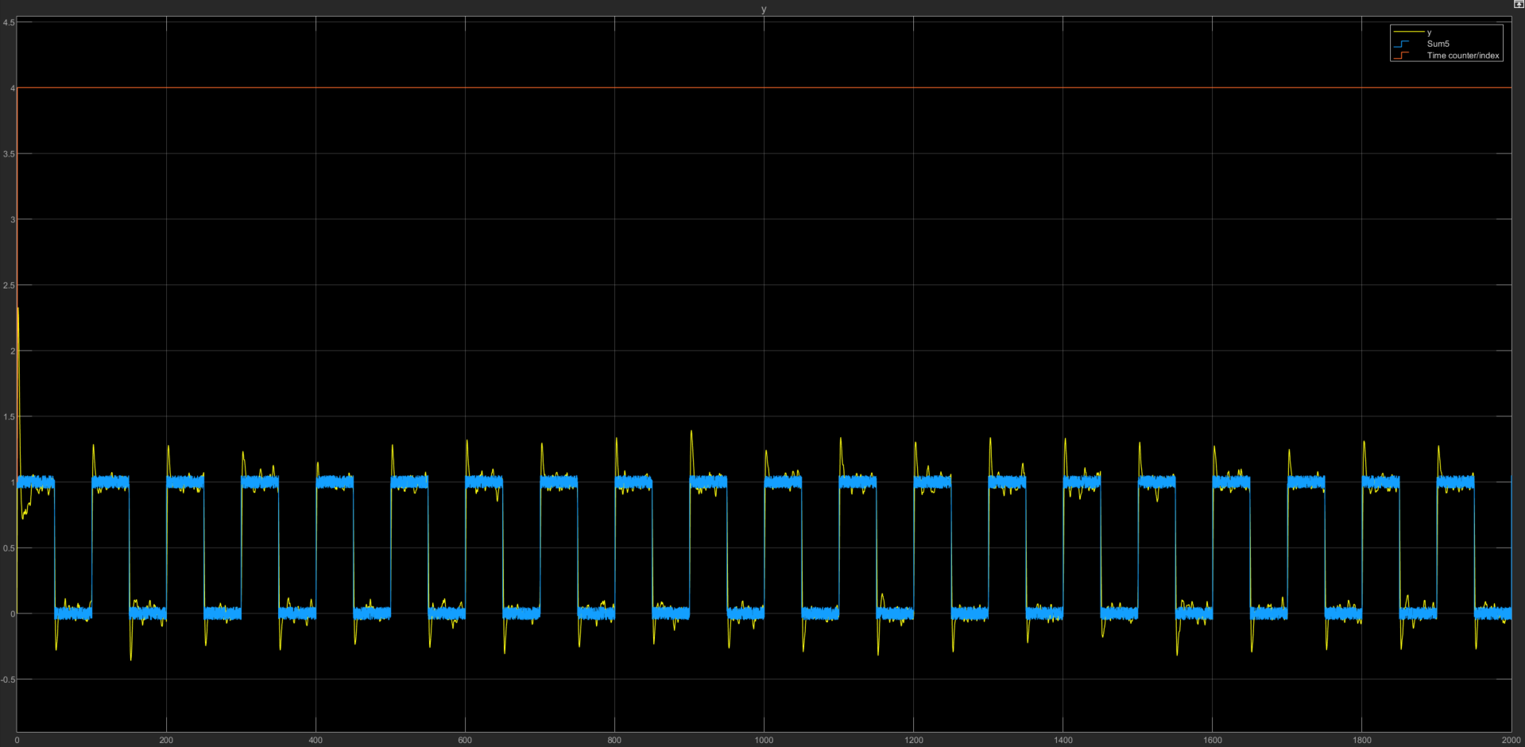
Final Design - System response
Dwell time = 1s
Disturbance signal before plant = [-0.1, 0.1] random number steps
Blue: reference input + excitation
Yellow: Plant output
Orange: controller in the loop
System quickly switches to the desired controller (C4), with some initial switching transients

Slide 9
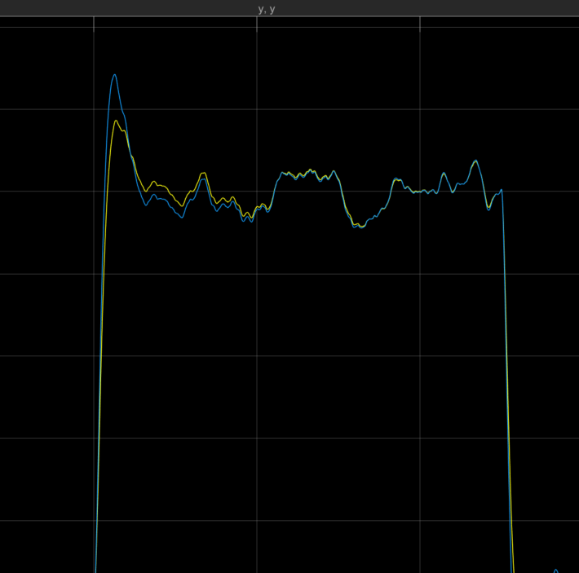
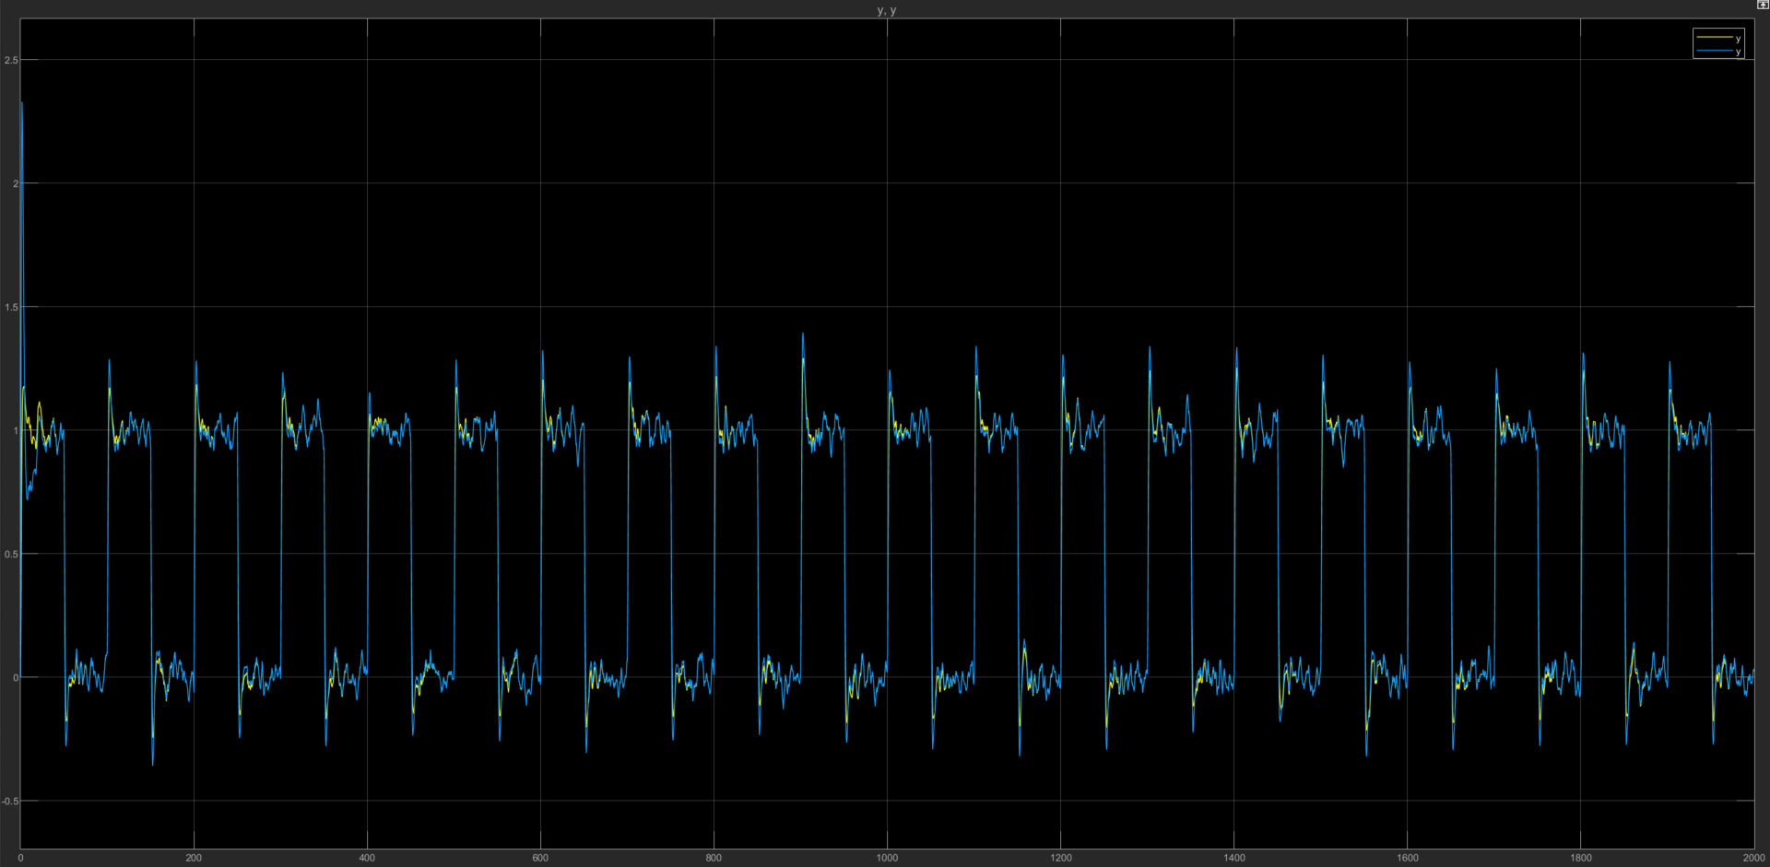
System Response: Comparison with fixed controller
Comparing same controller (C4) in different loop:
The most obvious is the initial transients before switching to controller 4
There is also slight overshoot differences and response to disturbances
Fixed controller response vs Switching controller response

Slide 10
Summary
Benefit of the switching mechanism as shown would be combining different PID characteristics for better transient and steady-state performance
We attempted to introduce some input perturbation to the plant, but the controller outputs are too different in steady state to have an effect.
Implementing larger number of controllers might give us insight to potential improvement with more switching between controllers that are better at different scenario.

Slide 11
Reference
[1] Unfalsified Adaptive Control - A new Controller Implementation
[2] The Unfalsified Control Concept and Learning

